Slide 1
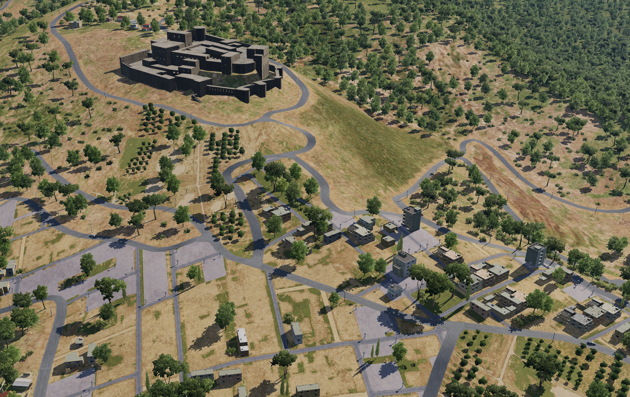

SYTGT091 Syrian Intelligence office
N
91
1
DESCRIPTION OF THE DESIRED POINTS OF IMPACT WITH WPN TYPE:
SYTGT091A – Intelligence Office
DPI 1 N 34 45.545 E 036 17.790/1982ft/(500 Ibs bomb)
SYTGT091A – 3 storey buildings made of concrete slab supported by reinforced concrete base and pillars, flat poured roof, requires delayed fuzing.
Suggested fuzing solution on DPI 1 – contact to open up the roof followed by delayed to pierce through floors and affect building structure.
SYTGT091A
4
5
6
Collateral damage – Historic building within 170m.
7
8

